Slide 1

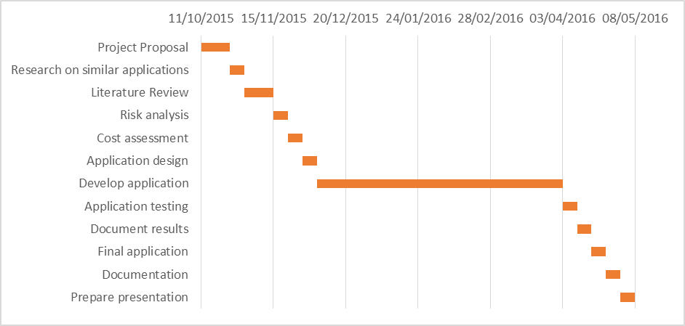
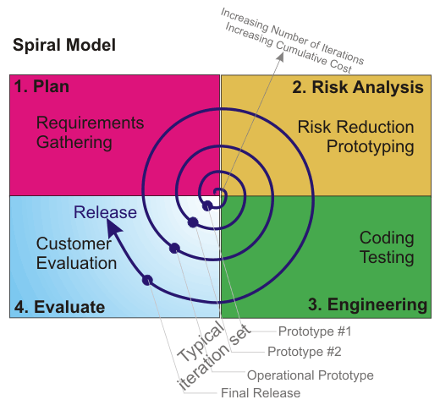
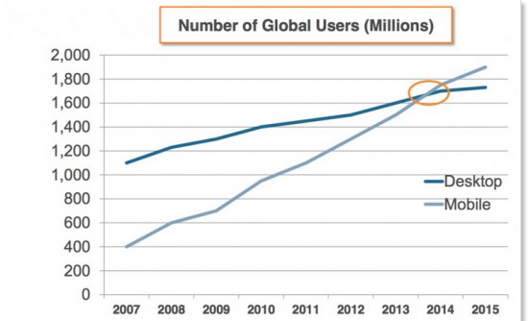
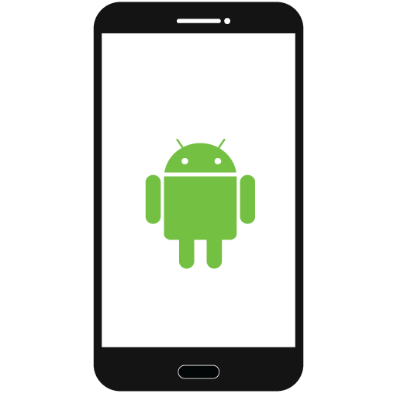


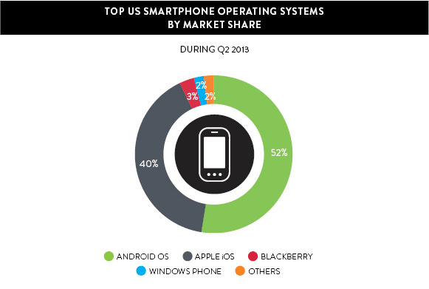
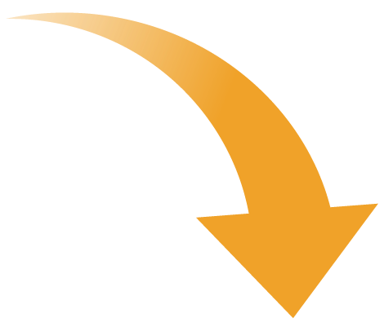

Medical Management Mobile Application for Android
Nicky Randles (B00058026) Supervisor: Stephen O'Shaughnessy
Introduction
The goal of this project is to create a android application which helps doctors and their patients manage appointments.
Research Questions:
Is there an actual need for an application like this in medical practices?
Who are the target audiences for the application?
What will each target audience find useful in the application?
How does the application compare to others already available on the market?
What is the correct approach to make the application as user friendly as possible?
Technologies:
Software: Android APIs, Java, MySQL, HTML, CSS, PHP, JSON
Currently developing android application with plans to create web application.
Hardware: Samsung Galaxy S5
Deliverables:
An android application which can be successfully installed on all android devices
Technical Challenges:
Developing an application which is efficient at managing the user’s medical information and is user friendly.
Developing an application which is able to securely hold the user’s sensitive medical data.
Developing an application which implements good principles such as a good privacy policy.
Project Plan
The project has been broken down into several different stages which start at the beginning of Semester 1 and finish at the end of Semester 2. They are shown in the Gantt chart below.
Methodologies
The Software Development Life Cycle model I think is best suited for this project is the Spiral model. I think it is the best SDLC for this project as it involves a lot of testing which will help me to end up with a better final application.
Planning Phase: In this phase requirements and objectives are gathered.
Risk Analysis Phase: In this phase risks are identified and are analysed. Alternative solutions are also evaluated.
Engineering Phase: In this phase the software is developed and testing is carried out.
Evaluation Phase: In this phase the user is able to evaluate the project output so far before it takes its next spiral.
The main advantage of the spiral model is that it reduces the chances of project failure. This is achieved through extensive risk analysis. By carrying out risk analysis it can help avoid risks which could cause the project to fail.
Results
By applying the methodology a working prototype has been successfully completed. The prototype allows the users to management there medical affairs day by the day with the calendar implemented in the application. The following features have been successfully implemented so far:
The user can register and enter in their details.
They can communicate with there registered doctors and book an appointment,
When an appointment is booked it will be placed in their calendar.
The user will be remaindered about their appointment as the date approaches.
Background
The mobile application development is fastest growing trend in the IT industry. The is a high demand for mobile application because of the hugh growth in mobile device ownership. It overtook desktop ownership in 2014 making it a more promising path of development.
Conclusion
Based upon the research that has been conducted, developing an android mobile application seems like the most promising path of development. It feels like the project is justified after all the research that was carried out. A basic implementation has been completed which has implemented only some of the features which have been planned. The project has completed is first cycle of its software development life cycle. Since the SDLC is the spiral model, planning, risk analysis, engineering and testing have all taken place. I have also evaluated the project and I am happy with its current position. I feet that will not fail and it is ready for its next cycle.
There is a number of different mobile operating systems to choose from to develop the application in but which one is the most promising. Android has the majority of the market share over all other operating systems. It is also believed that it has better developer tools and is more flexible. Android is open and its software development kit helps developers get their applications across as many platforms as possible. This makes it a strong choose over the others.
Future Work
Since the prototype is only a basic implication of the expected final result it will need to be expanded upon. In the next semester, the plan is to implement a number of the features which were inspired from the research conducted. It will need to incorporate all of the technologies that have been outlined. The efficiency of the project will need to be improved and it will have to use the knowledge gain from the research to tend to the targets audiences needs more.

